Slide 1

Asia IT BrownBag Demo
A Simple DB Meter using Kafka/Azure Event Hub/Azure Stream Analytics Job/PowerBI

Slide 2

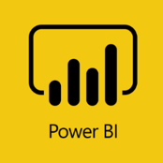


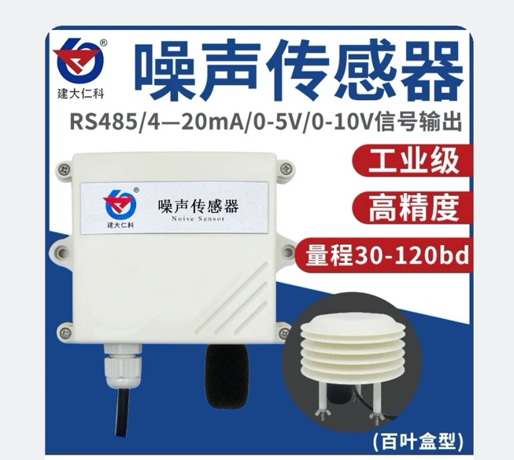




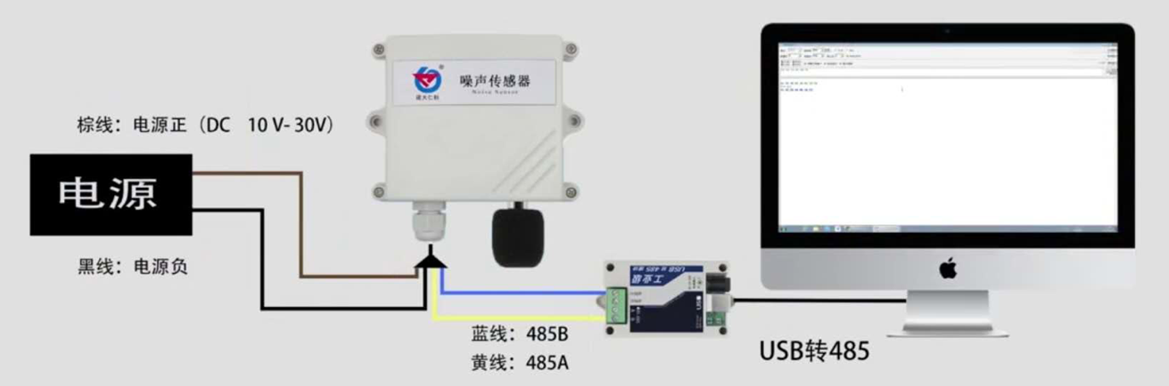
What will we build?
Cloud
Components & High Level Architecture
Bus
Mirror
Maker
Edge

Slide 3
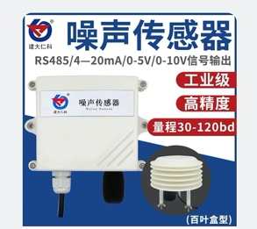
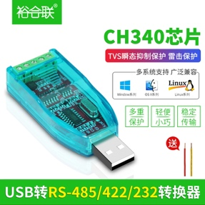
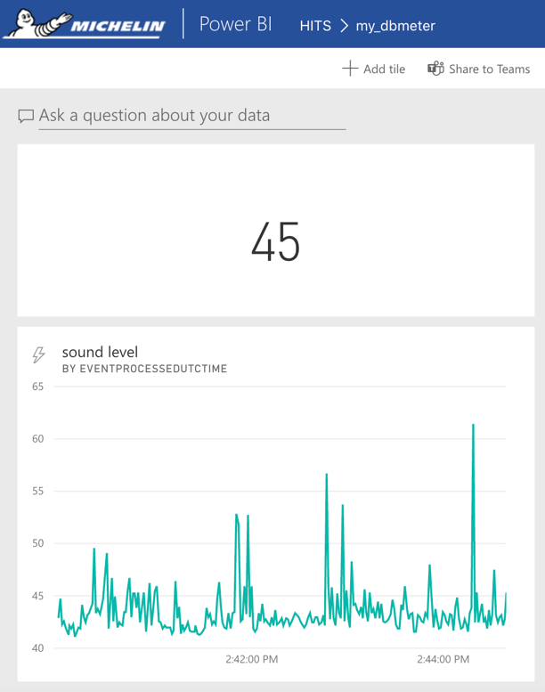
Component | OTC (RMB/USD) | MRC (RMB/USB) | Comments
 | 240 RMB/ 34 USD | 0 | Bought from Taobao.com
 | 35 RMB/ 5 USD | 0 | Bought from Taobao.com
Power Adaptor | 34 RMB/ 5 USD | 0 | Bought from Taobao.com
Azure Event Hub (standard, 1 thoughtput unit, no capture) |  | 154 RMB/ 22 USD | · Need standard tier to support Kafka endpoint · 1 throughput unit allows 1MB/s ingress and 2MB/s egress · Deployed in Central US
Azure Stream Analytics (standard, 1 streaming unit) |  | 560 RMB/ 80 USD | · Deployment in Central US · Default streaming unit is 3
PowerBI license |  | 0 | · Come with company O365 suit
What is cost?
One-Time-Cost & Monthly-Recurring-Cost

Slide 4
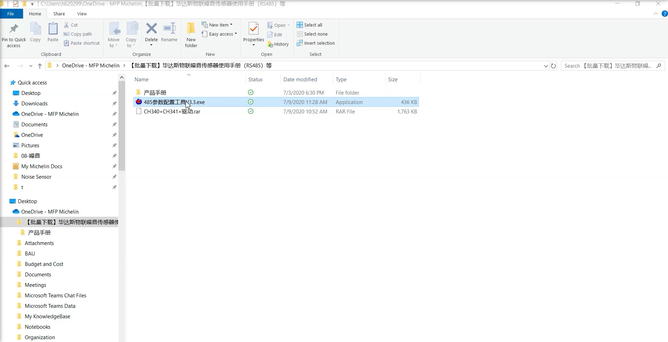
Step 1: Get the devices ready
Buy the noisy sensor/RS485 to USB convertor/Power Adapter
Connect to the PC (Michelin Windows 10 PC)
Check and ensure the devices are working

Slide 5
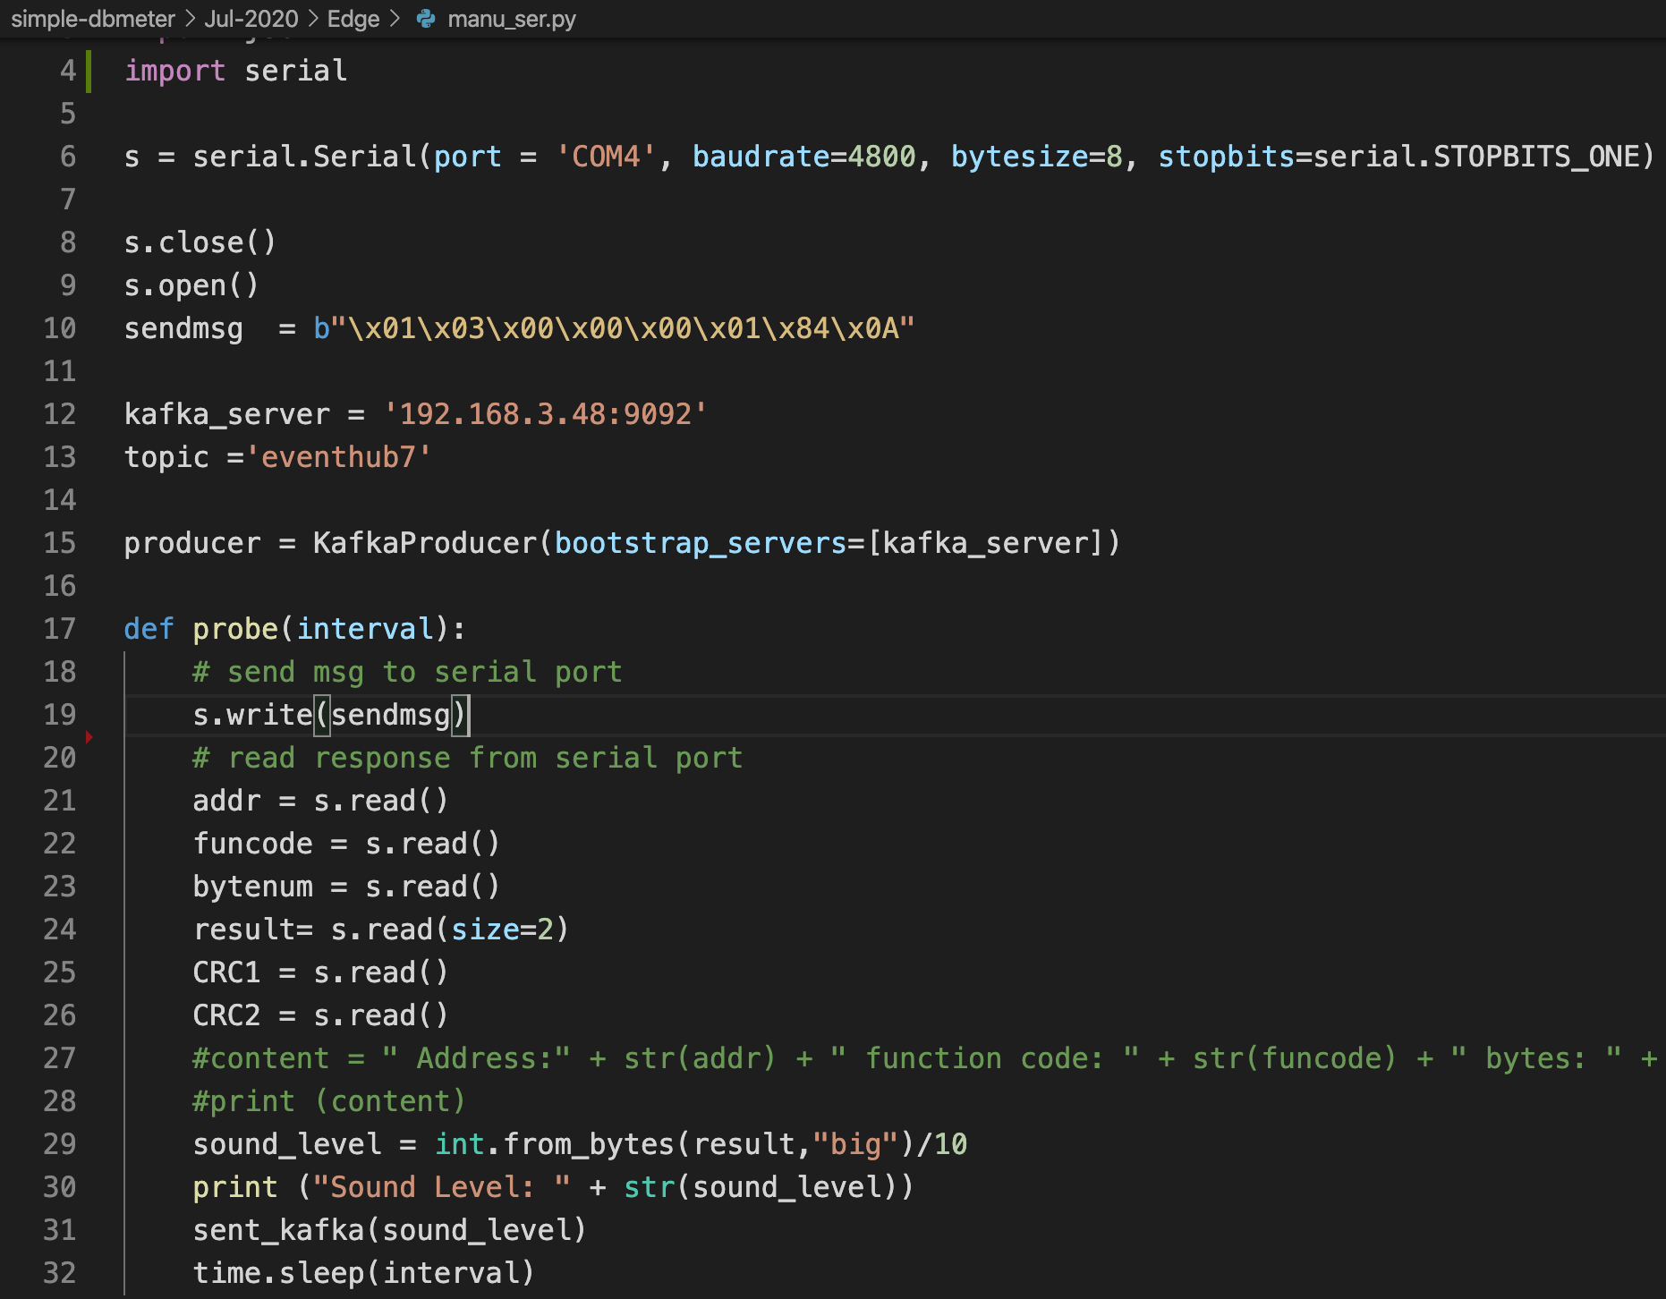
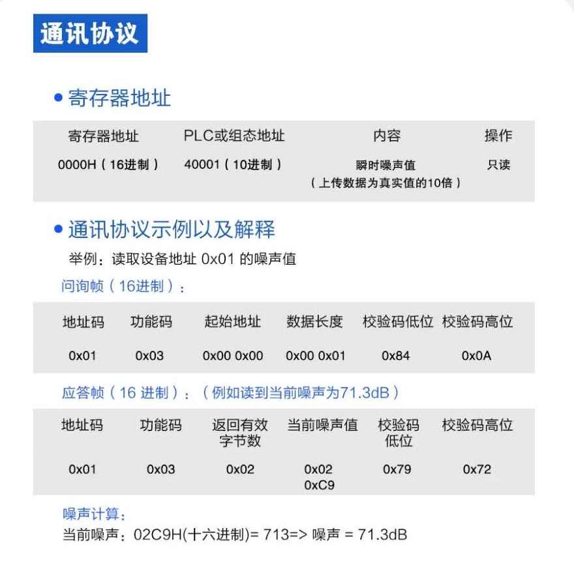
Step 2: Write the Perl script to read from serial port
Open the COM port
Send a query string
Read the response with defined protocol
Calculate the result DB value

Slide 6
Step 3: Set the Kafka cluster on Bus box (MacOS X)
=== install Kafka =====
brew install kafka
=== check network environment ====
(Mobile hotspot)
PC: 192.168.43.85
Bus Box (Mac): 192.168.43.121
=== update the Kafka configuration
[server.properties]
advertised.listeners=PLAINTEXT://192.168.43.121:9092
=== start the Kafka =====
cd /usr/local/etc/kafka/
zookeeper-server-start zookeeper.propoerties
cd /usr/local/etc/kafka/
kafka-server-start server.properties
=== create the topic ====
kafka-topics --create --topic eventhub7 --bootstrap-server 127.0.0.1:9092
=== watch the messages ====
kafka-console-consumer --topic eventhub7 --from-beginning --bootstrap-server 127.0.0.1:9092

Slide 7
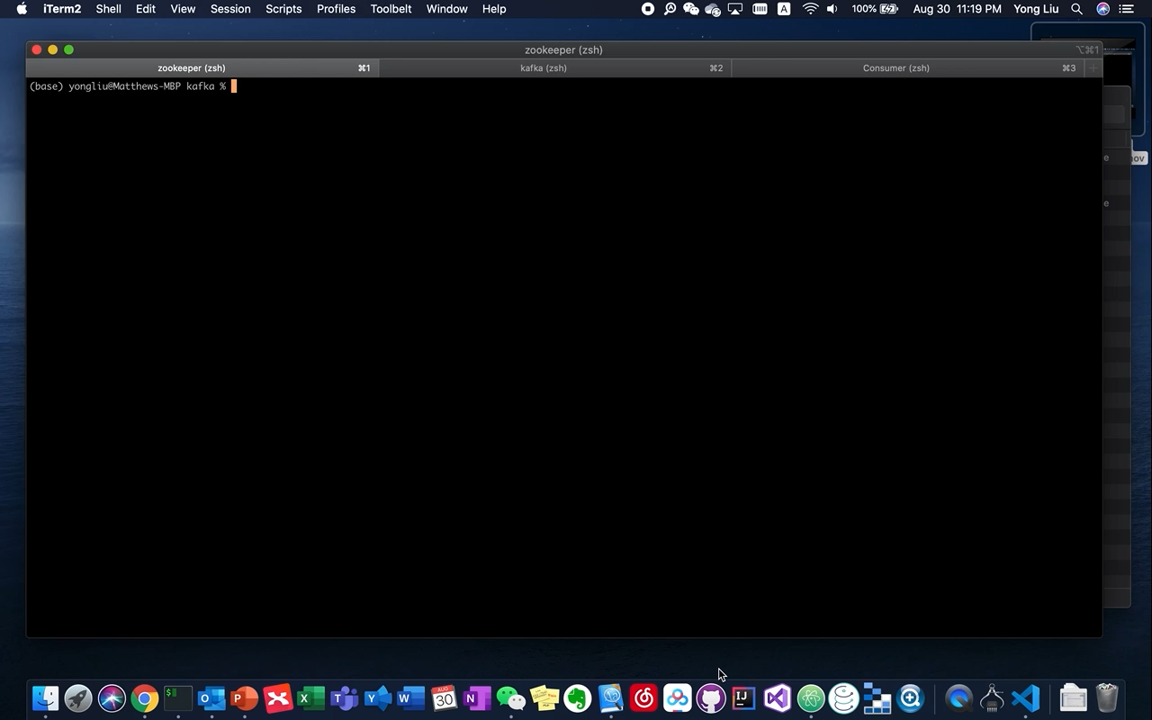
Start Kafka cluster & console consumer

Slide 8
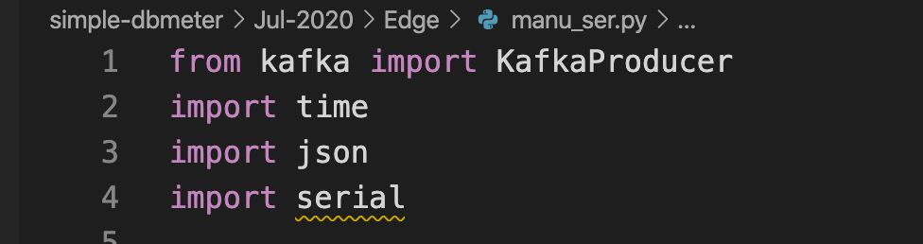
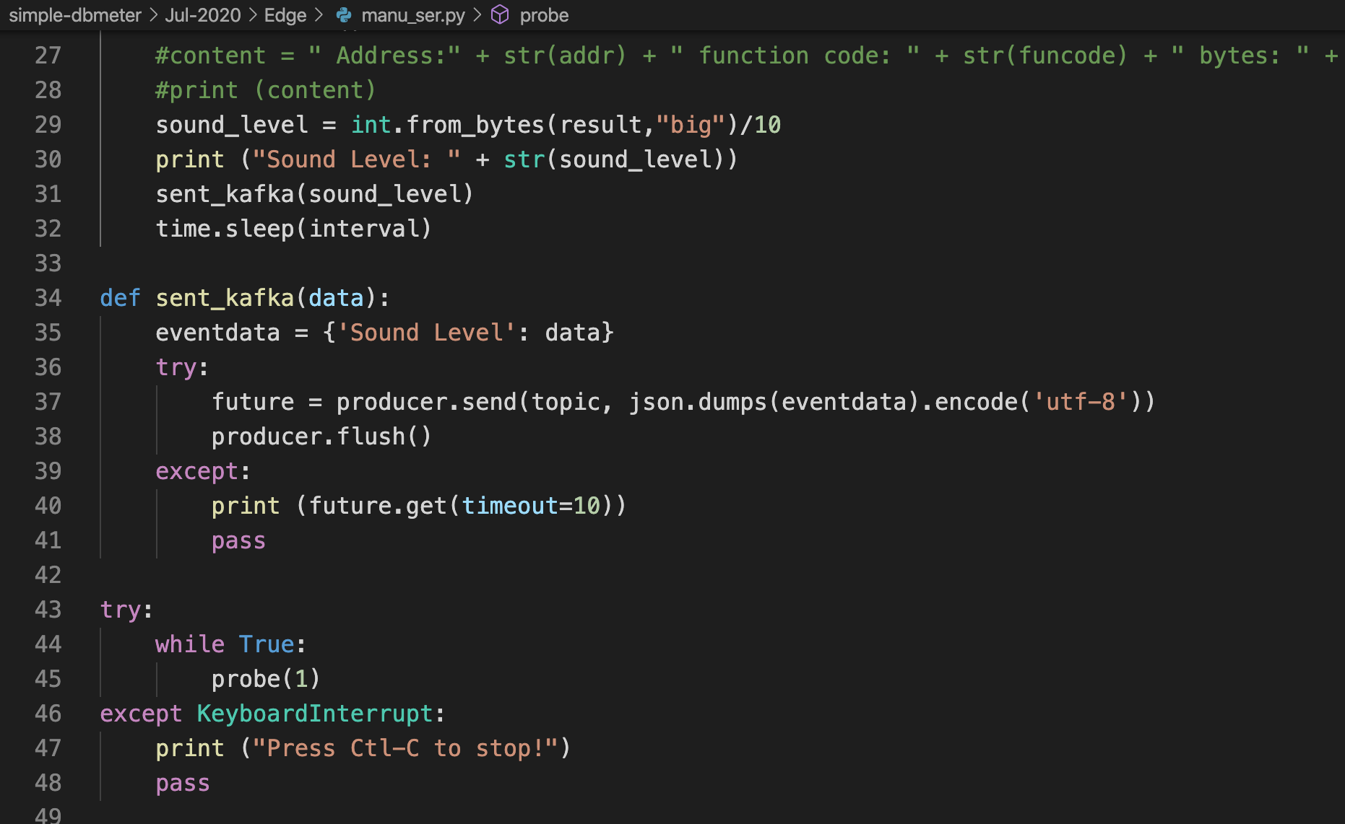
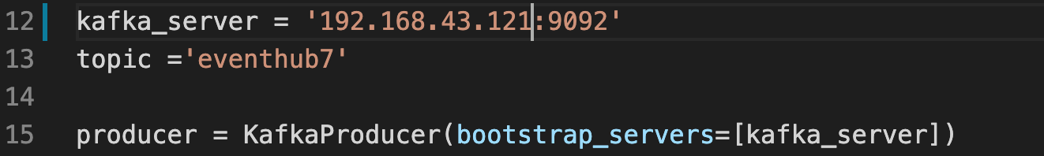
Step 4: Update Python script to send the DB value to Kafka

Slide 9
Kafka and Event Hub conceptual mapping
Kafka Concept | Event Hubs Concept
Cluster | Namespace
Topic | Event Hub
Partition | Partition
Consumer Group | Consumer Group
Offset | Offset

Slide 10
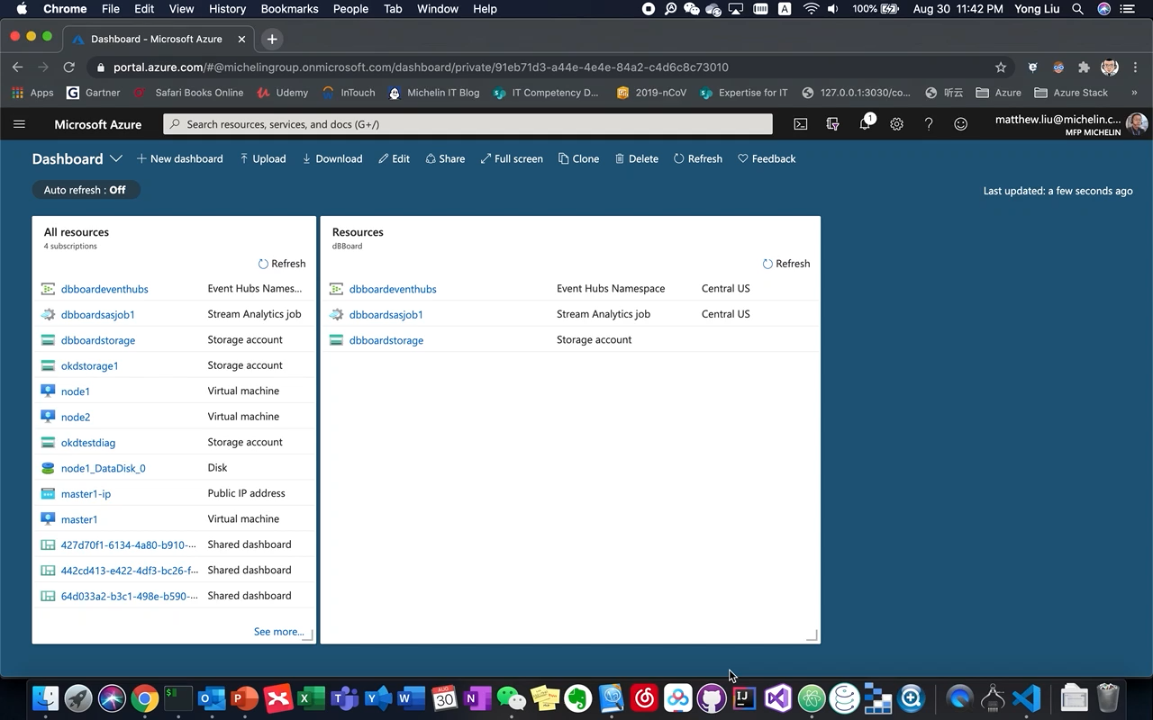
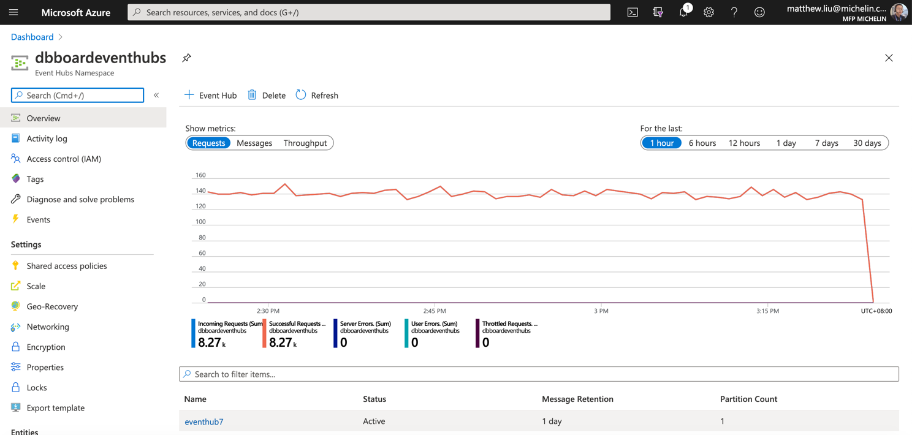
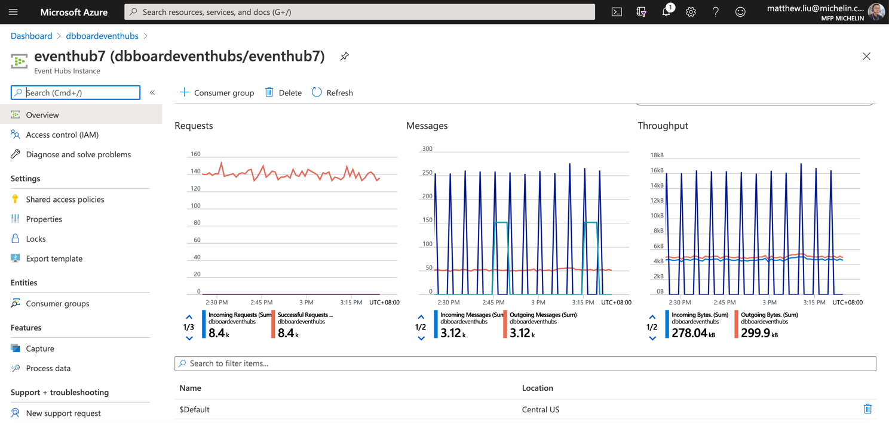
Step 5: Setup the Azure Event Hub

Slide 11
Step 6: Setup MirroMaker to replicate messages from Kafka to EventHub
=== update MirrorMaker configure files====
1) consumer: souurce-kafka.config
ensure the "bootstrap.servers=127.0.0.1:9092"
2) produucer: mirror-eventhub.config
Set the bootstrap.servers = your EventHub URL:9093
Replace the password field with your EventHub connection string
=== start the Kafka Mirror Maker ====
kafka-mirror-maker --consumer.config source-kafka.config --num.streams 1 --producer.config mirror-eventhub.config --whitelist=".*"

Slide 12
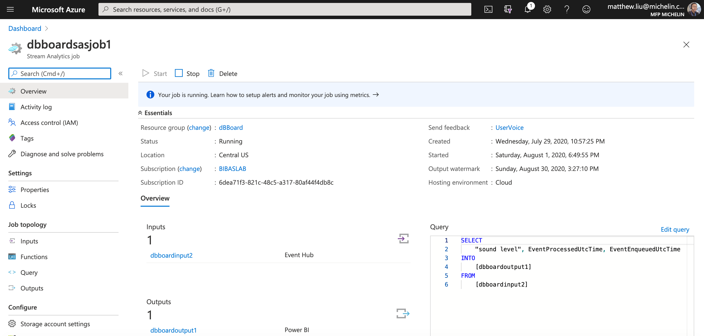
Step 7: Create the Azure Stream Analytics Job

Slide 13
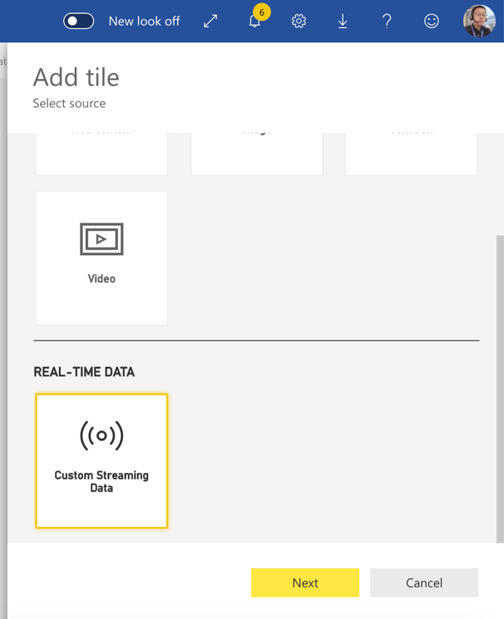
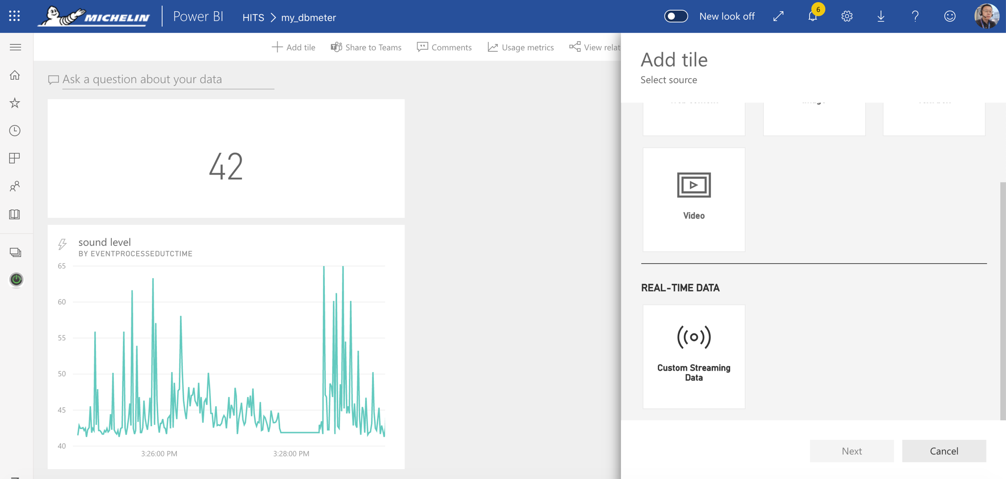
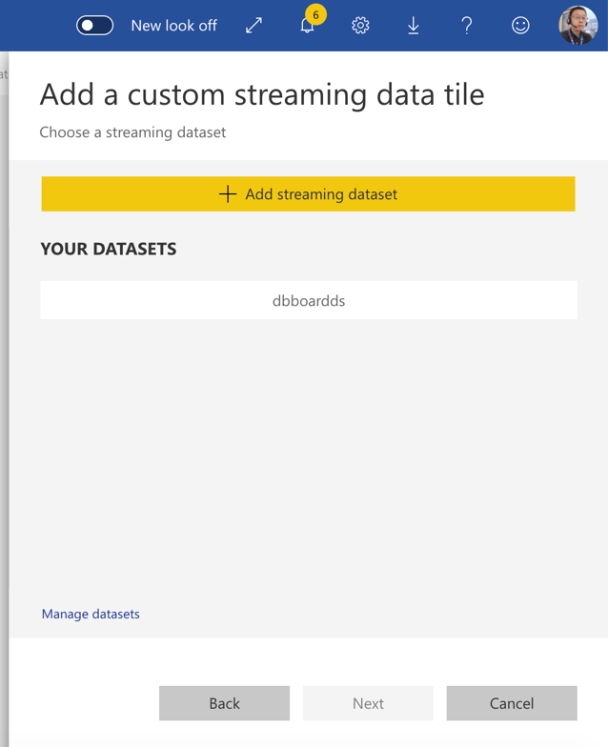
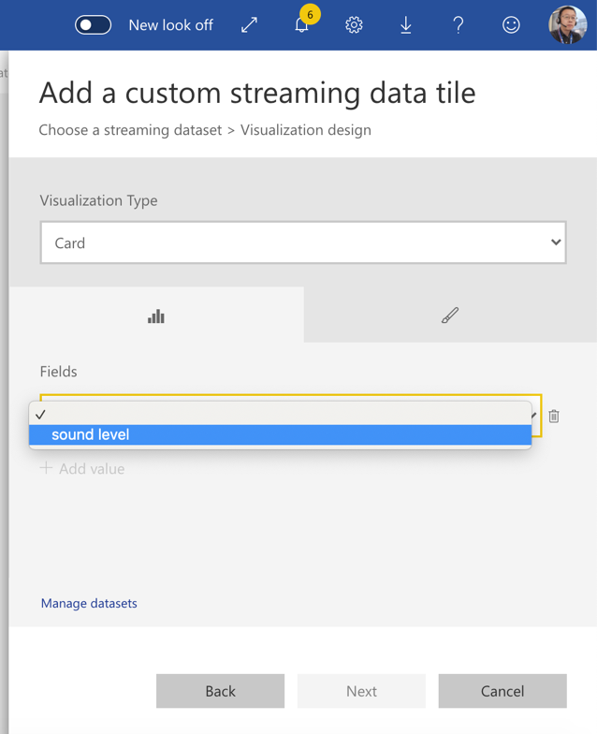
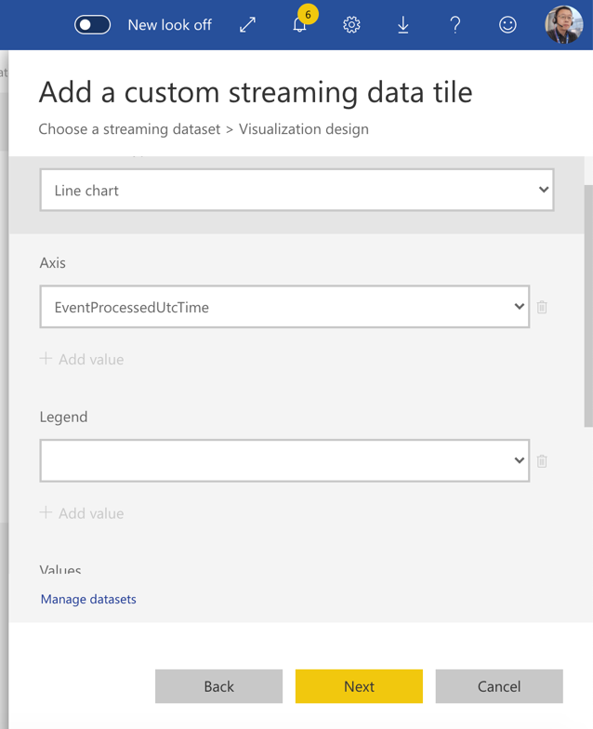
Step 8: Create the PowerBI dashboard

Slide 14
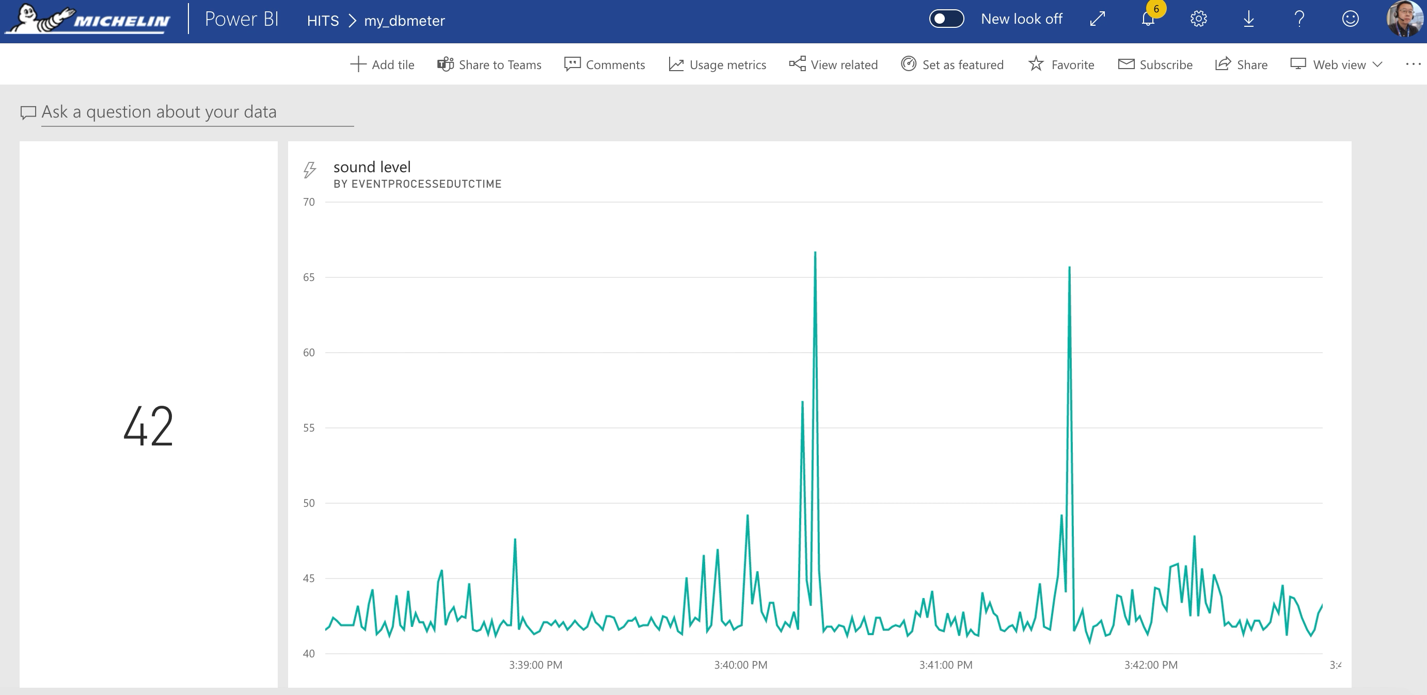
Result

Slide 15
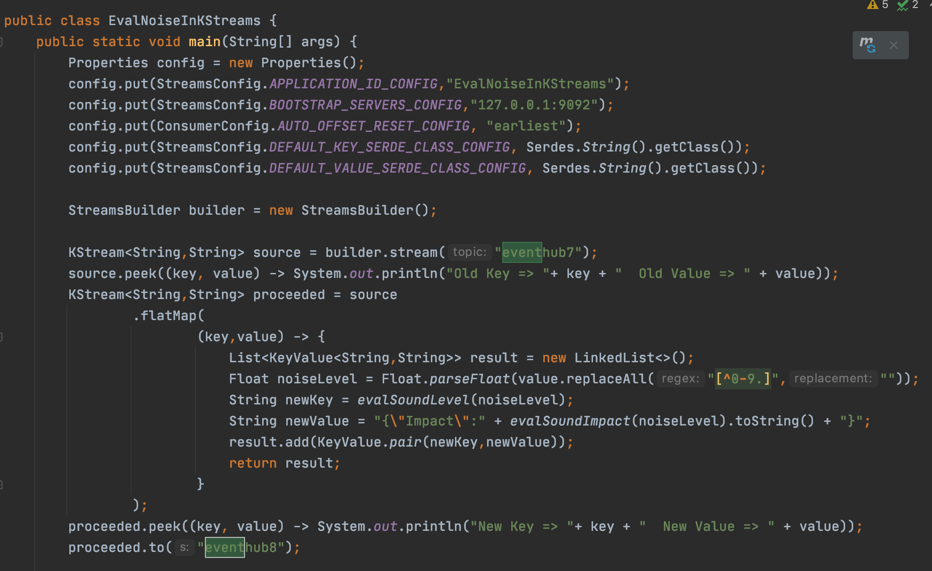
Step 9 Kafka streams application – stateless transformation
Define properties for the streams
Read from Kafka into KStream
Transform into a new KStream
And output to Kafka
Notes:
Input: eventhub7 {"Sound Level": 46.7}
Output: eventhub8 {"Impact":2}

Slide 16
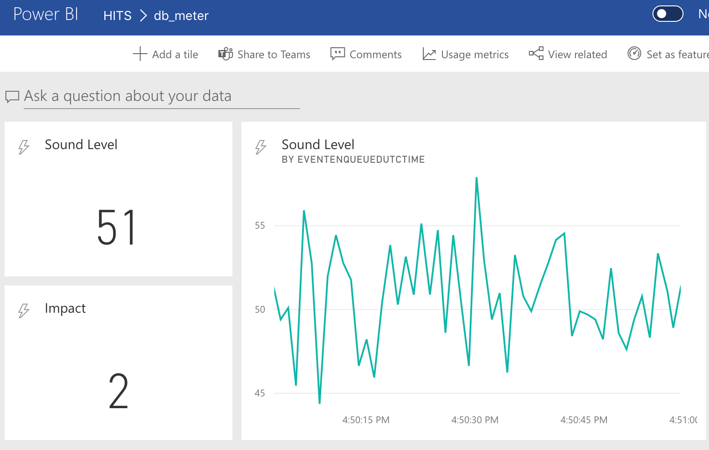
Updated Dashboard

Slide 17
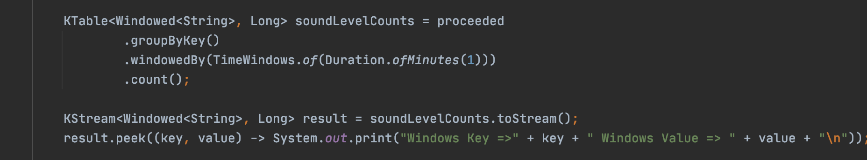
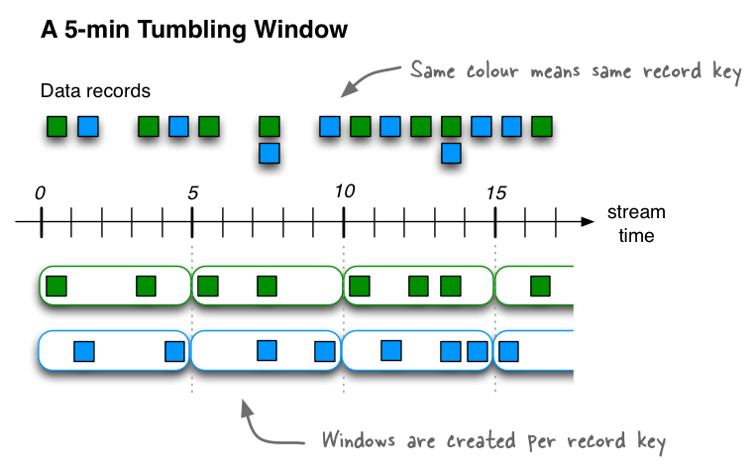
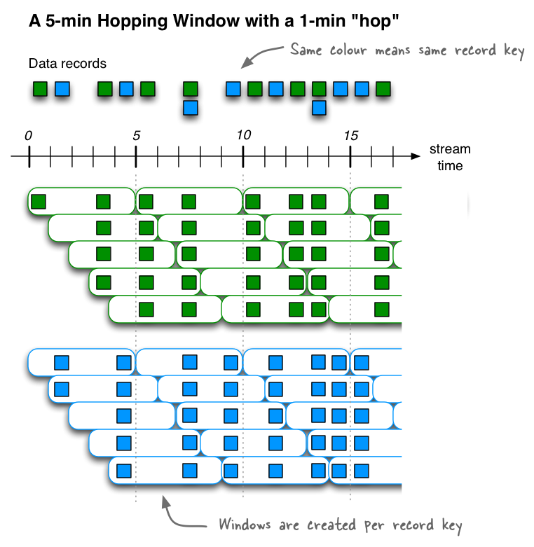
Step 10 Kafka stream application – stateful transformation

Slide 18
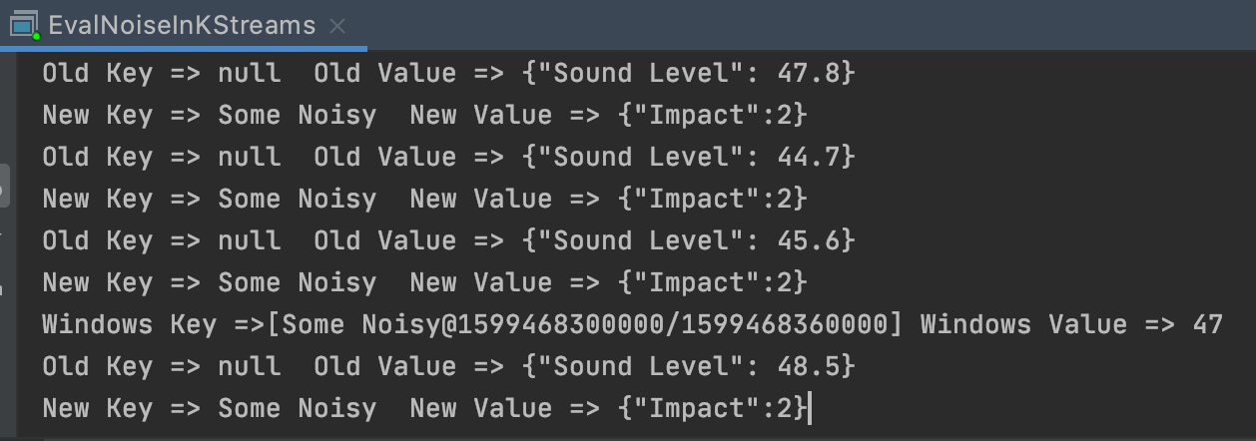
Summary of the transformations
Kafka
Topic: EventHub7
Kafka
Topic: EventHub8
Old Key/Old Value
FlatMap
Results:
Kstream:
‘Proceeded’
New Key/New Value
Groupbykey
(windowed)
Count
KTable:
soundLevelCounts
KStream:
result
Windowed Key/Windowed Value

Slide 19

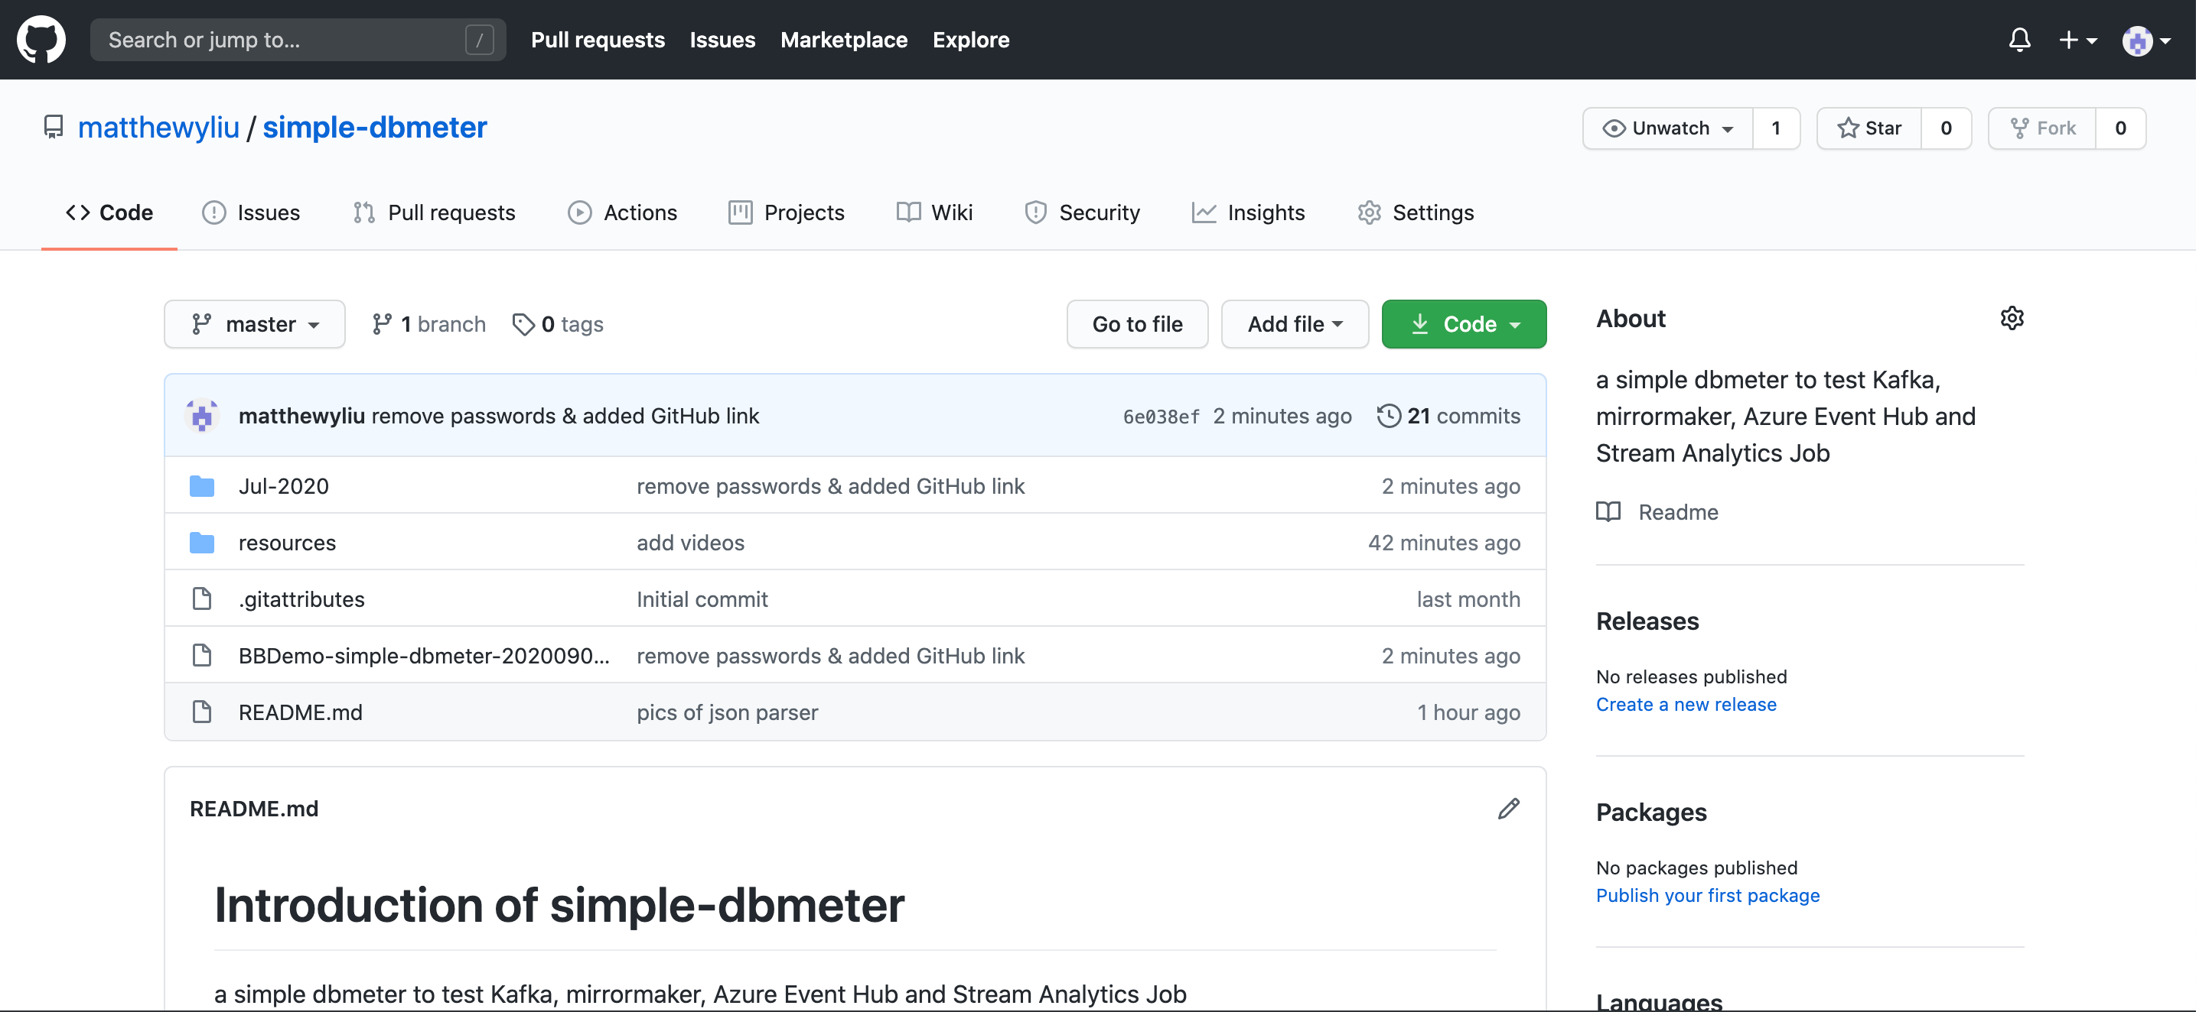
Online Repository
https://github.com/matthewyliu/simple-dbmeter

